Slide 1


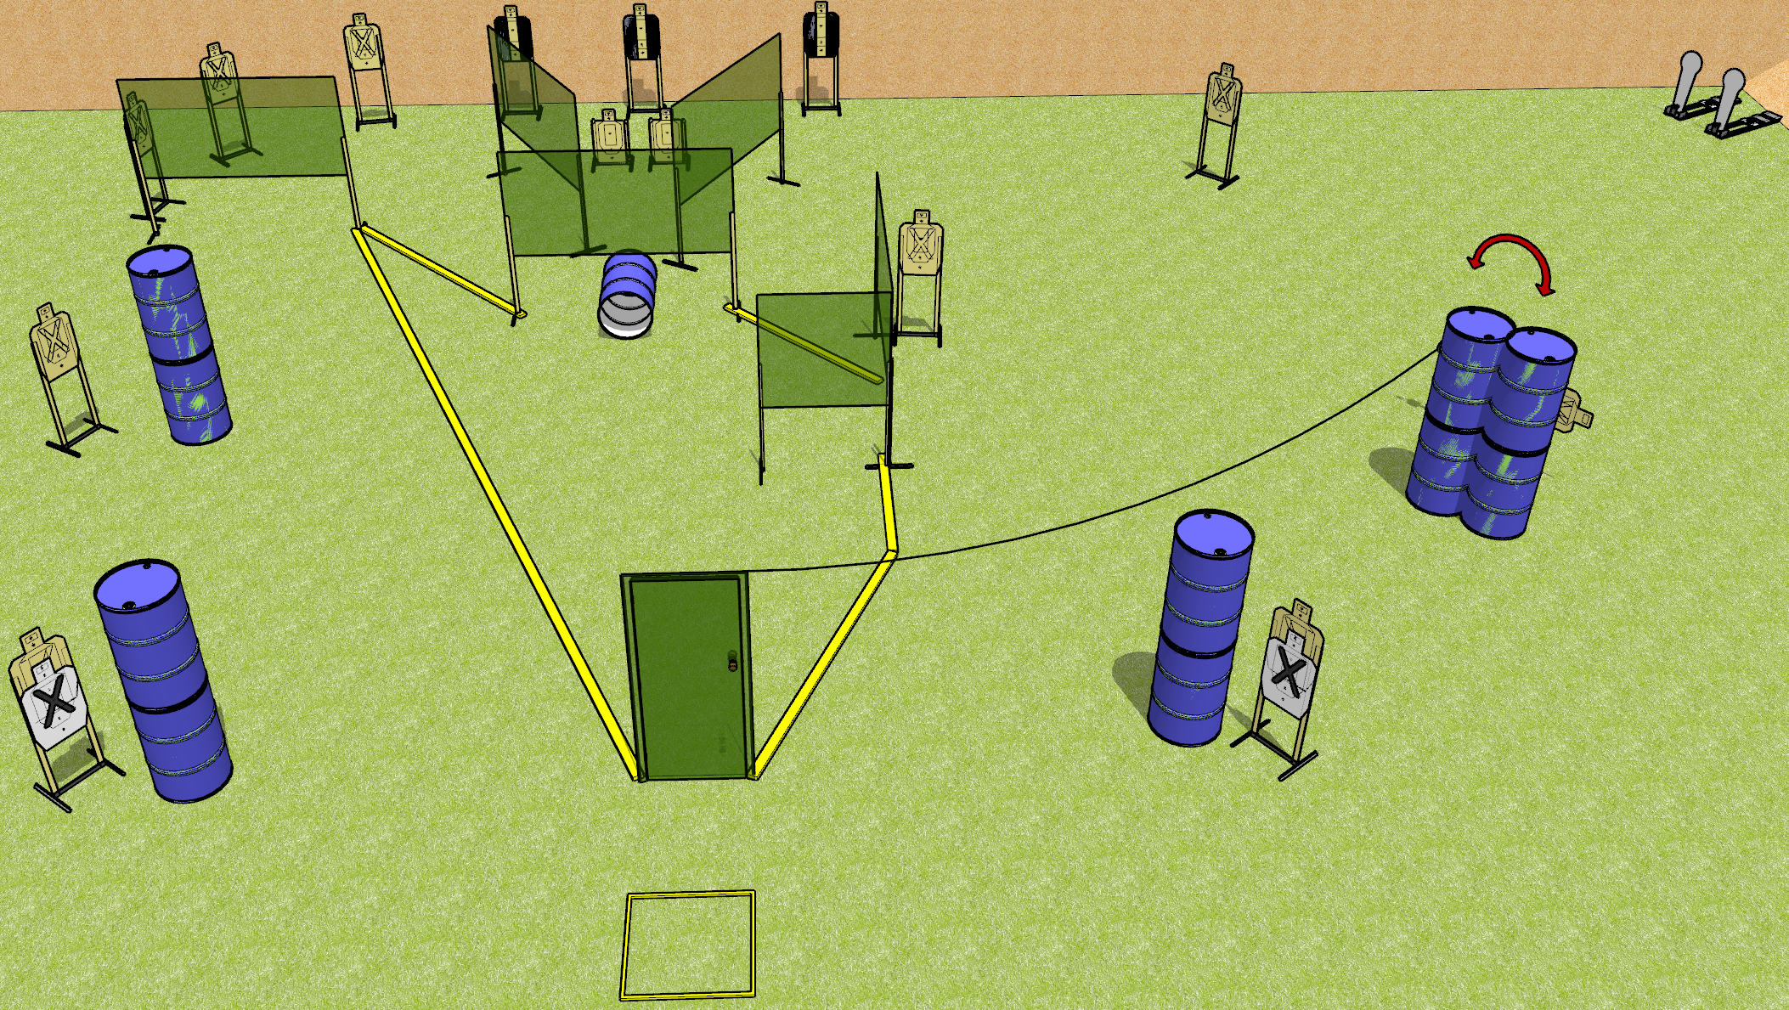
 | Dothan Gun Club – USPSA Match Low Blow Course Designer : Drew Coleman
START POSITION : Standing in start box, wrists above shoulders.
GUN READY CONDITION : Pistol loaded and holstered. PCC loaded, buttstock on belt, safety on, pointed in a safe direction. |  | SCORING: Comstock, 30 rounds TARGETS: 14 paper, 2 Steel SCORED HITS: Best 2 on paper, steel until down START-STOP: Audible, last shot RULES:
STAGE PROCEDURE: Engage targets as they become available from within the fault lines.

Slide 2
Low Blow
Written Stage Briefing
Low Blow is a 30 round, 150 point, Comstock field course. There are fourteen USPSA targets and two Colt poppers. The best two hits on paper will score, and steel must fall to score. The start signal is audible.
Handgun start position is standing in start box with wrists above respective shoulders. Handgun is loaded and holstered.
PCC start position is standing in start box with buttstock on belt, muzzle pointed in a safe direction. Loaded carbine is held with both hands, safety on.
Upon start signal, engage targets as they become available from within the fault lines. The swinging target is activated by opening the door and it is visible at rest.

